Slide 1
QUIZ SOFTWARE MANAGEMENT SYSTEM
Name- Sajal Kumar
Shivam Sonkar
Roll no. 33,36
USING PYTHON AND SQL.

Slide 2
QUIZ SOFTWARE MANAGEMENT SYSTEM
Quiz is a wonderful way to test one’s knowledge . But when it comes to storing the data is a structured and schematic way it is a hectic task so in order to tackle this problem we must have a data management system for this ,so this work of software management will not only help you to store the data but will also help you to maintain a detailed record of your quiz programme. ENJOY!!!!!!

Slide 3
QUIZ SOFTWARE MANAGEMENT SYSTEM OBJECTIVES OF THE PROJECT

Slide 4
QUIZ SOFTWARE MANAGEMENT SYSTEM
OBJECTIVES OF THE PROJECT
The objective of this project is to allow the management to maintain a clean and structured detail of their quiz programme.
Write programs utilizing modern software tools.
Apply simple principles effectively when developing small to medium sized projects.
Write effective procedural code to store small to medium sized information.
Students will demonstrate a breadth of knowledge in computer science, as exemplified in the areas of systems, theory and software development.
Students will demonstrate ability to conduct a research or applied Computer Science project, requiring writing and presentation skills which exemplify scholarly style in computer science.

Slide 5
QUIZ SOFTWARE MANAGEMENT SYSTEM
PROPOSED SYSTEM
Today one cannot afford to rely on the fallible human beings of be really wants to stand against today’s merciless competition where not to wise saying “to err is human” no longer valid, it’s outdated to rationalize your mistake. So, to keep pace with time, to bring about the best result without malfunctioning and greater efficiency so to replace the unending heaps of flies with a much sophisticated hard disk of the computer.
One has to use the data management software. Software has been an ascent in atomization various organisations. Many software products working are now in markets, which have helped in making the organizations work easier and efficiently. Data management initially had to maintain a lot of ledgers and a lot of paper work has to be done but now software product on this organization has made their work faster and easier. Now only this software has to be loaded on the computer and work can be done.
This prevents a lot of time and money. The work becomes fully automated and any information regarding the organization can be obtained by clicking the button. Moreover, now it’s an age of computers of and automating such an organization gives the better look.

Slide 6
QUIZ SOFTWARE MANAGEMENT SYSTEM
SYSTEM DEVELOPMENT LIFE CYCLE (SDLC)
The systems development life cycle is a project management technique that divides complex projects into smaller, more easily managed segments or phases. Segmenting projects allows managers to verify the successful completion of project phases before allocating resources to subsequent phases.
Software development projects typically include initiation, planning, design, development, testing, implementation, and maintenance phases. However, the phases may be divided differently depending on the organization involved.
For example, initial project activities might be designated as request, requirements-definition, and planning phases, or initiation, concept-development, and planning phases. End users of the system under development should be involved in reviewing the output of each phase to ensure the system is being built to deliver the needed functionality.

Slide 7
QUIZ SOFTWARE MANAGEMENT SYSTEM
PHASES OF SYSTEM DEVELOPMENT LIFE CYCLE
INITIATION PHASE
The Initiation Phase begins when a business sponsor identifies a need or an opportunity.
The purpose of the Initiation Phase is to:
Identify and validate an opportunity to improve business accomplishments of the organization or a deficiency related to a business need.
Identify significant assumptions and constraints on solutions to that need.
Recommend the exploration of alternative concepts and methods to satisfy the need including questioning the need for technology, i.e., will a change in the business process offer a solution?

Slide 8
QUIZ SOFTWARE MANAGEMENT SYSTEM
SYSTEM CONCEPT DEVELOPMENT PHASE
The System Concept Development Phase begins after a business need or opportunity is validated by the Agency/Organization Program Leadership and the Agency/Organization CIO.
The purpose of the System Concept Development Phase is to:
Determine the feasibility and appropriateness of the alternatives . Identify system interfaces.
Identify basic functional and data requirements to satisfy the business need.
Establish system boundaries; identify goals, objectives, critical success factors, and performance measures.
Evaluate costs and benefits of alternative approaches to satisfy the basic functional requirements
Assess project risks

Slide 9
QUIZ SOFTWARE MANAGEMENT SYSTEM
SOURCE CODE
import mysql.connector
mydb=mysql.connector.connect(host="localhost",user="root",passwd="manager",database="quiz_comp")
mycursor=mydb.cursor()
mycursor.execute("create table questions1(qno_no int(3) primary key , qno_desc varchar(10000),opt_a varchar(500), opt_b varchar(500), opt_c varchar(500) ,opt_d varchar(500) , ans varchar(5000))")
print("QUIZ SOFTWARE")
print("1.questions")
print("2.participants")
print("3.scores update")
print("4.display")
choice=int(input("enter your wish:"))

Slide 10
QUIZ SOFTWARE MANAGEMENT SYSTEM
sql_in= "insert into questions1 values(" + str( sql) + ",'" + (sql1)+ "'"+",'" + (sql2) + "'"+",'" + (sql3) +"'" +",'"+ (sql4) +"'"+",'" + (sql5) +"'"+ ",'"+(sql6) +"'"")"
mycursor.execute(sql_in)
mydb.commit()
print("your request has been processed.Thank you for making us as a part of your project")
#mycursor.execute("create table participants(reg_no int(5) primary key, pname varchar(50) ,age_group int(10),city varchar(50),no_of_appearances_made int(10))")
if choice==2:
sql6=int(input("enter the participant reg_no:"))
sql7=input("enter the participant name:")
sql8=int(input("enter the age group:"))
sql9=input("enter the city:")
sql10=int(input("enter the no of appearances made:"))

Slide 11
QUIZ SOFTWARE MANAGEMENT SYSTEM
#mycursor.execute("create table scores(reg_no int(5) primary key , participant_name varchar(50),scores int(50),total_correct int(50),total_wrong int(50),total_attempted int(50))")
if choice==3:
a=int(input("enter the reg_no"))
b=input("enter the participants name")
c=int(input("enter the scores"))
d=int(input("enter the total correct answer"))
e=int(input("enter the incorrect answer"))
f=int(input("enter the no_of_attempted_questions"))
sql_insert="insert into scores values("+ str(a) +",'"+ (b) +"'"+",'"+ str(c)+"'"+",'"+ str(d) +"'"+ ",'"+str(e) +"'"+",'"+ str(f)+ "'"")"
print(sql_insert)
mycursor.execute(sql_insert)
mydb.commit()
if choice==4:
mycursor.execute("select * from questions1")
data=mycursor.fetchall()
print(data)

Slide 12
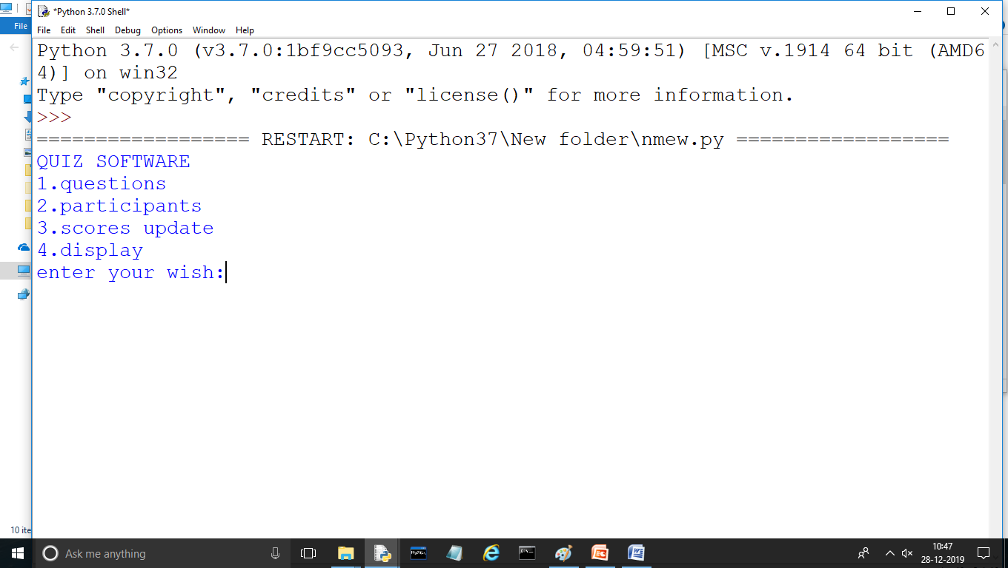
QUIZ SOFTWARE MANAGEMENT SYSTEM
OUTPUT

Slide 13
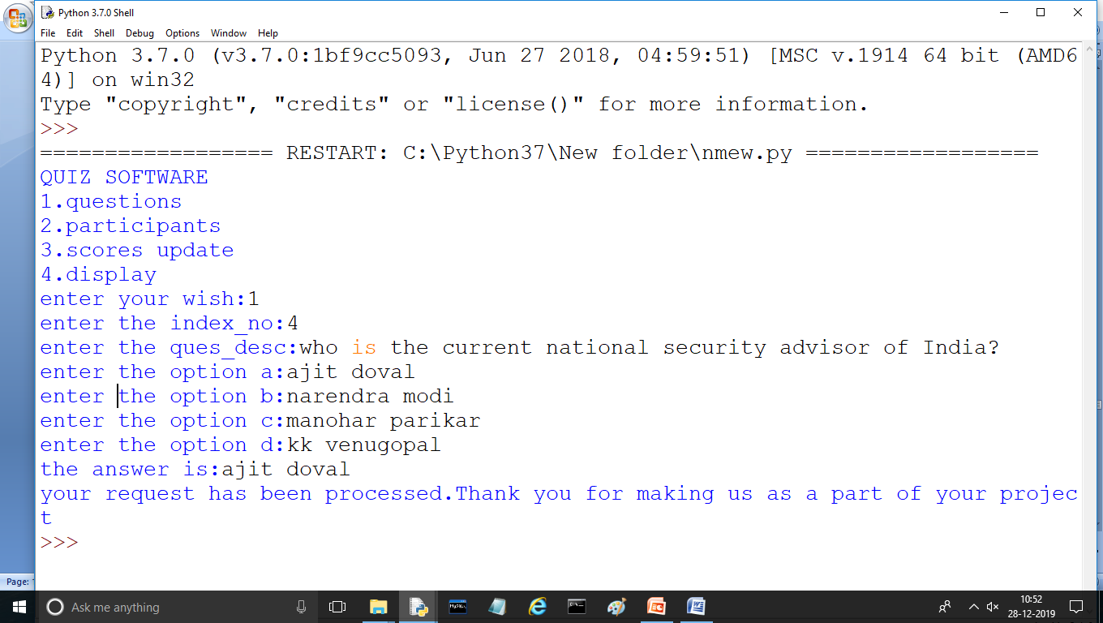
QUIZ SOFTWARE MANAGEMENT SYSTEM
OUTPUT

Slide 14
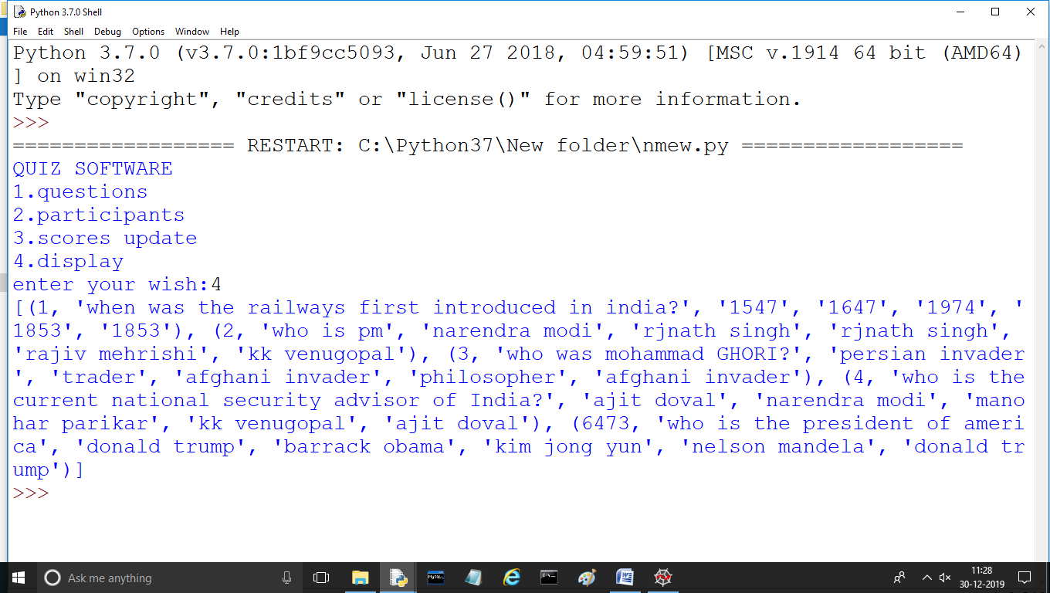
QUIZ SOFTWARE MANAGEMENT SYSTEM
OUTPUT

Slide 15
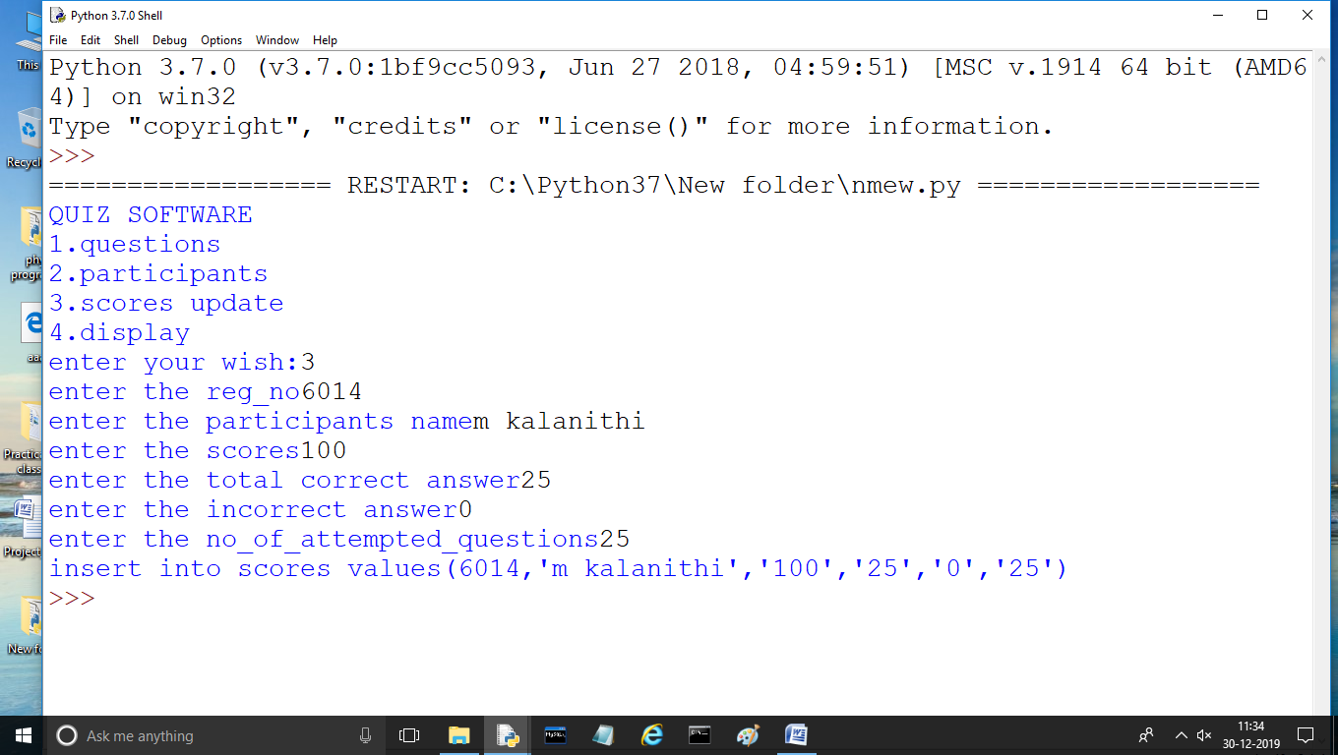
QUIZ SOFTWARE MANAGEMENT SYSTEM
OUTPUT

Slide 16
QUIZ SOFTWARE MANAGEMENT SYSTEM
TESTING
Software Testing is an empirical investigation conducted to provide stakeholders with information about the quality of the product or service under test[1] , with respect to the context in which it is intended to operate. Software Testing also provides an objective, independent view of the software to allow the business to appreciate and understand the risks at implementation of the software. Test techniques include, but are not limited to, the process of executing a program or application with the intent of finding software bugs.
It can also be stated as the process of validating and verifying that a software program/application/product meets the business and technical requirements that guided its design and development, so that it works as expected and can be implemented with the same characteristics. Software Testing, depending on the testing method employed, can be implemented at any time in the development process, however the most test effort is employed after the requirements have been defined and coding process has been completed.

Slide 17
QUIZ SOFTWARE MANAGEMENT SYSTEM
TESTING METHODS
Software testing methods are traditionally divided into black box testing and white box testing. These two approaches are used to describe the point of view that a test engineer takes when designing test cases.
BLACK BOX TESTING
Black box testing treats the software as a "black box," without any knowledge of internal implementation. Black box testing methods include: equivalence partitioning, boundary value analysis, all-pairs testing, fuzz testing, model-based testing, traceability matrix, exploratory testing and specification-based testing.
SPECIFICATION-BASED TESTING
Specification-based testing aims to test the functionality of software according to the applicable requirements.[16] Thus, the tester inputs data into, and only sees the output from, the test object. This level of testing usually requires thorough test cases to be provided to the tester, who then can simply verify that for a given input, the output value (or behaviour), either "is" or "is not" the same as the expected value specified in the test case.

Slide 18
QUIZ SOFTWARE MANAGEMENT SYSTEM
ADVANTAGES AND DISADVANTAGES
The black box tester has no "bonds" with the code, and a tester's perception is very simple: a code must have bugs. Using the principle, "Ask and you shall receive," black box testers find bugs where programmers don't. But, on the other hand, black box testing has been said to be "like a walk in a dark labyrinth without a flashlight," because the tester doesn't know how the software being tested was actually constructed.

Slide 19
That's why there are situations when (1) a black box tester writes many test cases to check something that can be tested by only one test case, and/or (2) some parts of the back end are not tested at all. Therefore, black box testing has the advantage of "an unaffiliated opinion," on the one hand, and the disadvantage of "blind exploring," on the other.

Slide 20
QUIZ SOFTWARE MANAGEMENT SYSTEM
CODE COMPLETENESS EVALUATION
White box testing methods can also be used to evaluate the completeness of a test suite that was created with black box testing methods. This allows the software team to examine parts of a system that are rarely tested and ensures that the most important function points have been tested.
Two common forms of code coverage are:
Function Coverage: Which reports on functions executed and
Statement Coverage: Which reports on the number of lines executed to complete the test.
They both return coverage metric, measured as a percentage.

Slide 21
QUIZ SOFTWARE MANAGEMENT SYSTEM
HARDWARE AND SOFTWARE REQUIREMENTS
I.OPERATING SYSTEM : WINDOWS 7 AND ABOVE
II. PROCESSOR : PENTIUM(ANY) OR AMD
ATHALON(3800+- 4200+ DUAL CORE)
III. MOTHERBOARD : 1.845 OR 915,995 FOR PENTIUM 0R MSI
K9MM-V VIA K8M800+8237R PLUS CHIPSET FOR AMD ATHALON
IV. RAM : 512MB+
V. Hard disk : SATA 40 GB OR ABOVE
VI. CD/DVD r/w multi drive combo: (If back up required)
VII. FLOPPY DRIVE 1.44 MB : (If Backup required)
VIII. MONITOR 14.1 or 15 -17 inch
IX. Key board and mouse
X. Printer : (if print is required – [Hard copy])

Slide 22
QUIZ SOFTWARE MANAGEMENT SYSTEM
.BIBLIOGRAPHY
Computer science With Python - Class XII By : Sumita Arora
Website: https://www.w3resource.com

Slide 23
THANK YOU
THE END

